Slide 1
Parts, Colors, and Markings

Slide 2
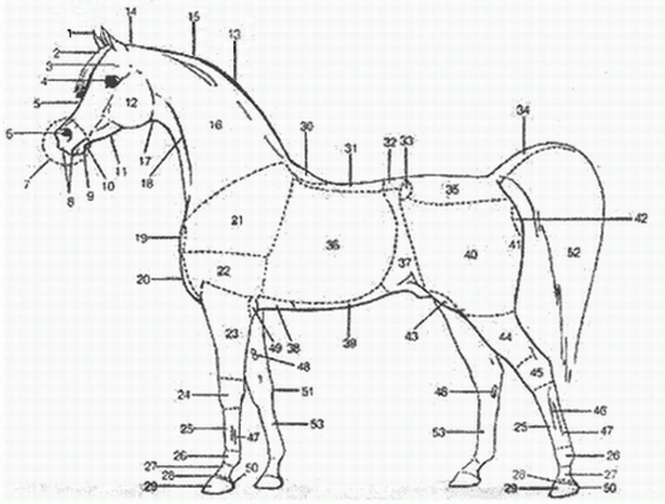
Parts of The Horse

Slide 3
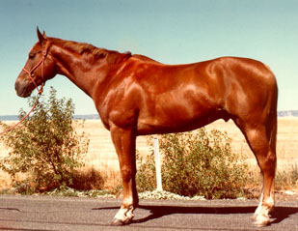
Sorrel/Chestnut
Body
or copper red
Mane and _______
Same
May be ___________

Slide 4
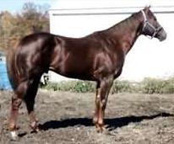
Liver Chestnut
Body
Dark or brownish-red
Mane and tail
Usually red
Brownish red
May be flaxen
legs red
May have dorsal stripe

Slide 5
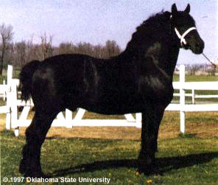
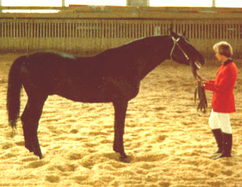
Black
Body color
True black light areas
Mane and tail
______________

Slide 6
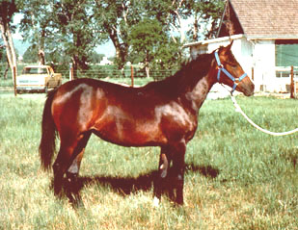
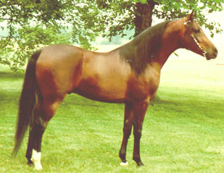
Bay
Body color
/ / reddish-brown
Mane and tail
Black
Black on legs

Slide 7
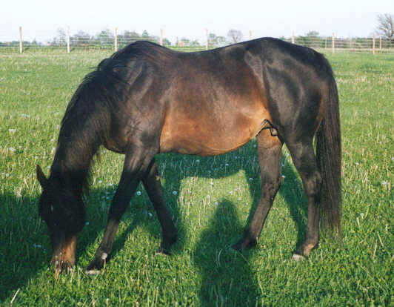
Brown
Body color
or black
Light areas
Muzzle
_________
Flank
Inside legs
Mane and tail
Black or _____________

Slide 8
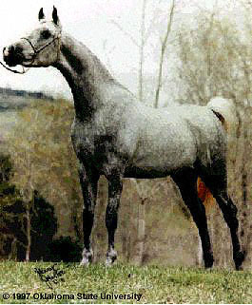
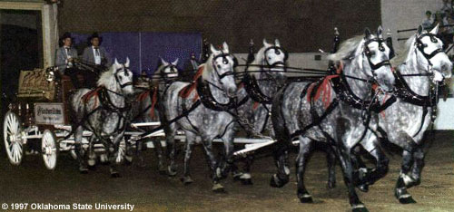
Gray
Body
Mixture of with any other colored hairs
Often born ___________
with age
May have dorsal stripe

Slide 9
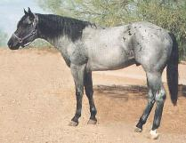
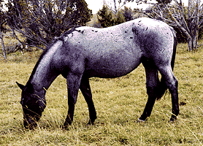
Blue Roan
Body
mixture of
white and hairs
Dark Points

Slide 10
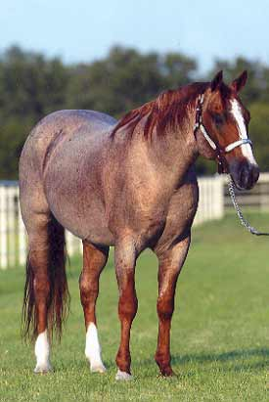
Red Roan
Body
mixture of white and hairs
Red on & lower legs
Red or __________ (blonde) mane & tail

Slide 11
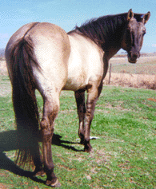
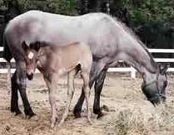
Grullo
Body
or mouse-colored
a mixture of black and white hairs
Each hair mouse colored
Mane and tail
Black
Black on legs
Usually has stripe

Slide 12
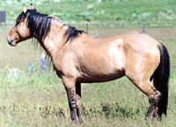
Dun
Body
or gold
Mane and tail
or brown
Dorsal stripe
stripes on leg
Transverse stripe over withers

Slide 13
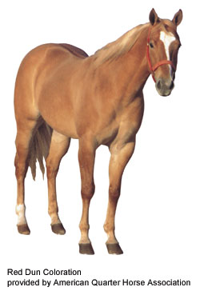
Red Dun
color
Form of dun
yellowish or colored
Mane and tail
or reddish
Flaxen
Red stripe
Zebra stripes
stripe

Slide 14
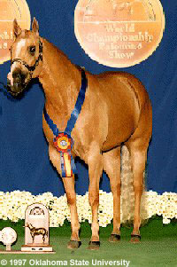
Palomino
Body
Golden _______________
Mane and tail
White
Typically dorsal stripes

Slide 15
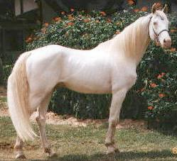
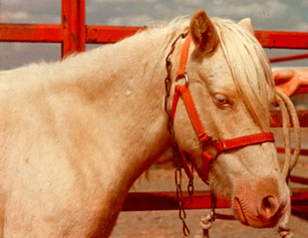
Cremello
Body color
or light cream
Mane and tail
White
or pinkish skin over entire body
eyes

Slide 16
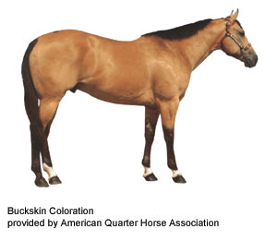
Buckskin
Body Color
Yellowish or _________
Mane and tail
Black
Usually black on legs
Typically do have dorsal stripes

Slide 17
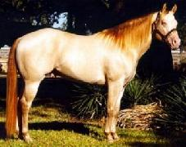
Perlino
Body color
White or light ___________
Mane and tail
Usually have a tint
Pale or orange
Pink or pinkish skin over entire __________
eyes

Slide 18
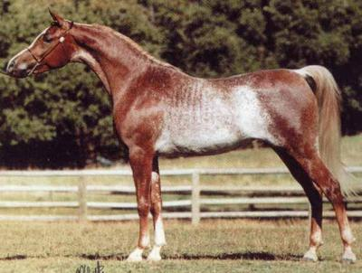
Rabicano
Body
Interspersed hairs
Most dense from flank to tail head
Roan

Slide 19
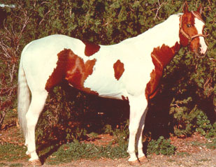
Pinto - Tobiano
color usually covers
One or both ______________
Generally
All four legs are __________
At least the hocks and knees
Spots
and distinct appearance of a shield

Slide 20
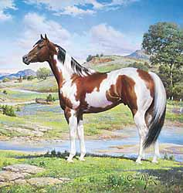
Pinto - Tobiano
Head markings
Like -colored horse
May have blaze, strip, star or snip
May be either
Predominantly or white
Tail is often colors

Slide 21
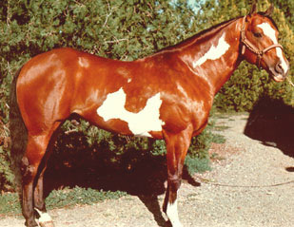
Pinto - Overo
White
usually will not cross ________ between withers and tail
Generally
At least one and often all four dark
White __________________
Scattered or splashy

Slide 22
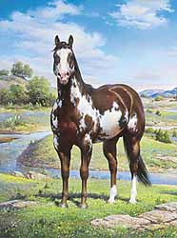
Pinto - Overo
Head markings often
-faced
May be either
predominantly or white
Tail usually color

Slide 23
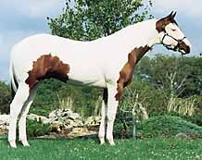
Pinto - Tovero
Dark pigmentation around _________
May expand to cover
and/or eyes
One or both eyes ________
Dark pigmentation around
____________
May extend up sides of face and form spots

Slide 24
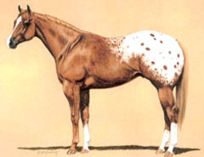
Appaloosa - Blanket
Solid area
Normally over
area
Contrasting color

Slide 25
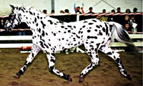
Appaloosa - Leopard
Predominantly
with spots of color over their body
Sometimes
Spots more concentrated _______ and areas
Spots may also occur
Direction hair grows
Most evident in the area

Slide 26
Facial Markings
Star: white mark on forehead
Stripe: narrow white mark down the face
Star & Stripe: connected star and stripe
Snip: white mark between the nostrils
Star, stripe, snip: connected star, stripe, and snip
Blaze: broad white mark down the face, extending over nose
Bald: very wide blaze, covering most of the face extending down over the nostrils

Slide 27
Facial Markings
Star: white mark on ________________
Stripe: white mark down the face

Slide 28
Facial Markings
Star & Stripe: star and stripe
Snip: white mark between the _____________

Slide 29
Facial Markings
Star, stripe, snip: star, stripe, and snip
Blaze: white mark down the face, extending over ___________

Slide 30
Facial Markings
Bald: very , covering most of the face extending down over the _______________ .
Must cross the ___________ of at least one eye

Slide 34
Leg Markings
Coronet: Just over the coronary band
Fetlock: Up to or halfway into the fetlock joint
Sock: Half way up the cannon bone
Stocking: Half way up the cannon bone and above (but not to cover the knee)

Slide 35
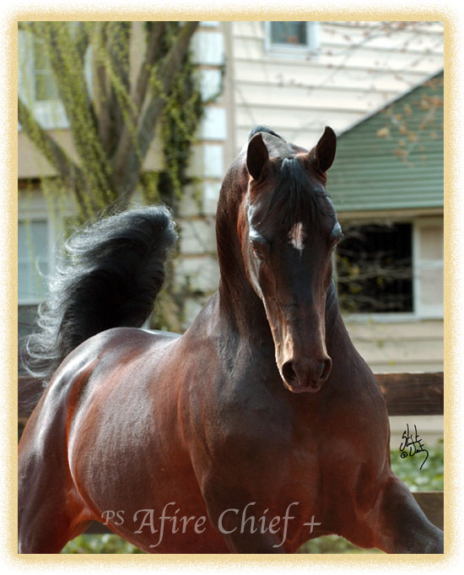
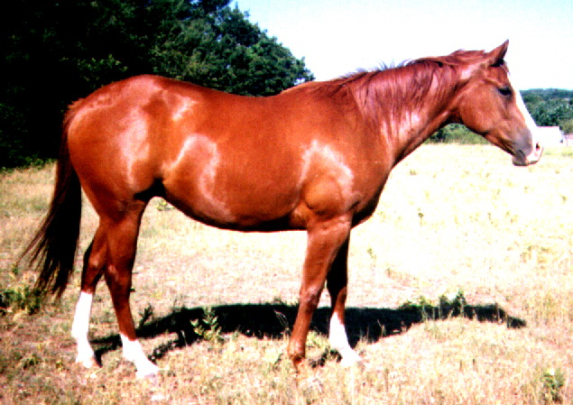
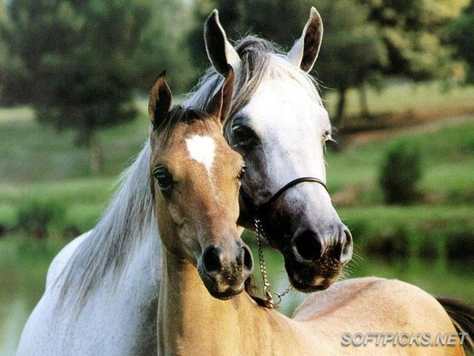
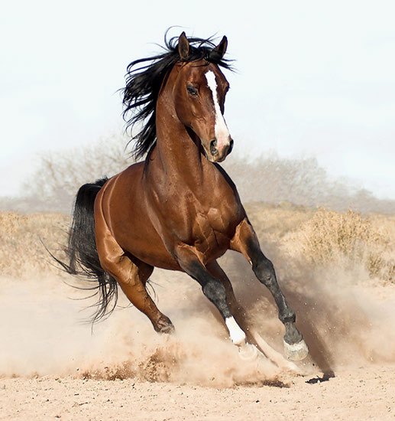
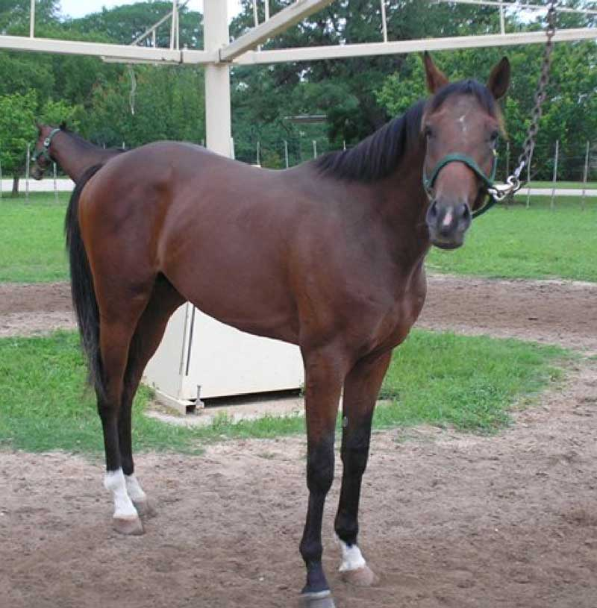
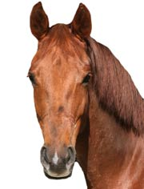
Identify the Markings

