Slide 1
Parts, Colors, and Markings

Slide 2
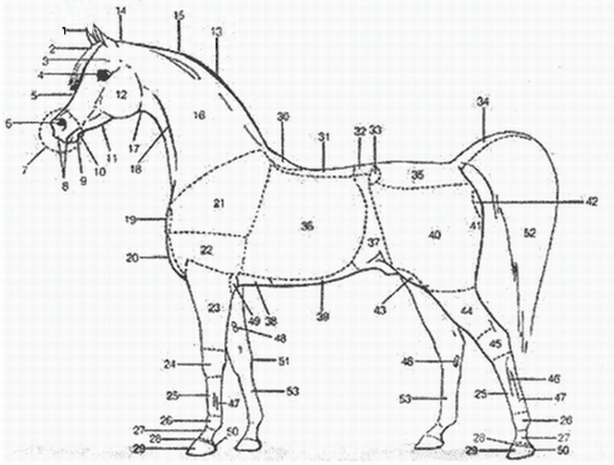
Parts of The Horse

Slide 3
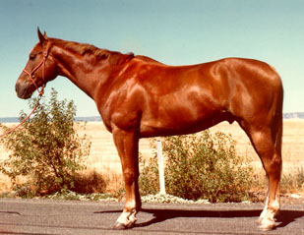
Sorrel/Chestnut
Body
Reddish or copper red
Mane and tail
Same
May be flaxen

Slide 4
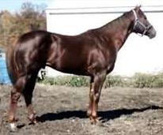
Liver Chestnut
Body
Dark red or brownish-red
Mane and tail
Usually dark red
Brownish red
May be flaxen
Lower legs red
May have dorsal stripe

Slide 5
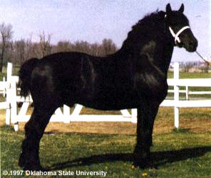
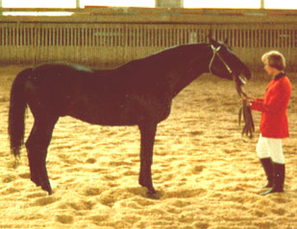
Black
Body color
True black without light areas
Mane and tail
Black

Slide 6
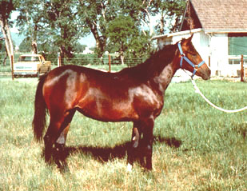
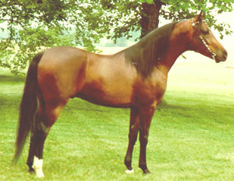
Bay
Body color
Tan / brown / reddish-brown
Mane and tail
Black
Black on lower legs

Slide 7
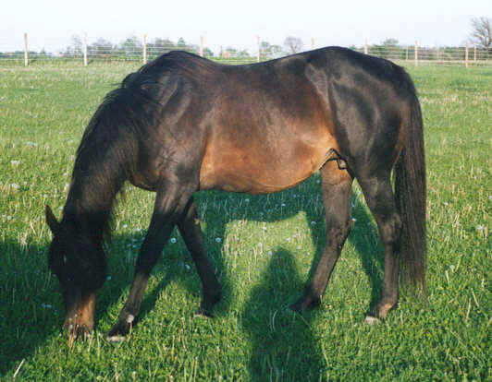
Brown
Body color
Brown
Possible light areas
Muzzle
Eyes
Flank
Inside upper legs
Mane and tail
Brown or dark brown

Slide 8
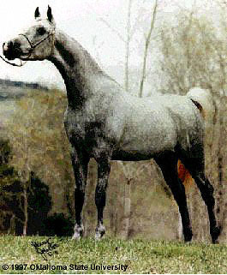
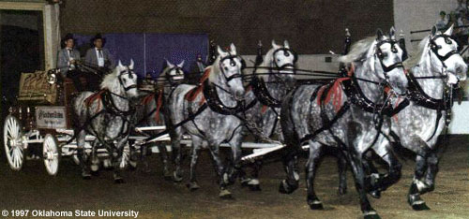
Gray
Body
Mixture of white with any other colored hairs
Often born solid
Lighter with age

Slide 9
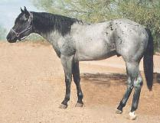
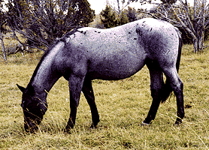
Blue Roan
Body
Uniform mixture of
white and black hairs
Black points and head

Slide 10
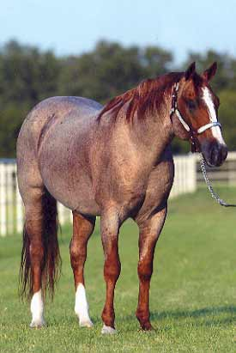
Red Roan
Body
Uniform mixture of white and red hairs
Red on head & lower legs
Red or flaxen (blonde) mane & tail

Slide 11
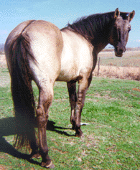
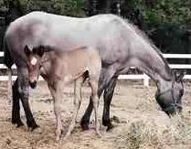
Grullo
Body
Smoky or mouse-colored
Not a mixture of black and white hairs
Each hair mouse colored
Mane and tail
Black
Black on lower legs
Usually has dorsal stripe (down back)

Slide 12
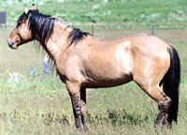
Dun
Body
Yellowish or gold
Mane and tail
Black or dark brown
Dorsal stripe
Possible zebra stripes on legs and transverse stripe over withers

Slide 13
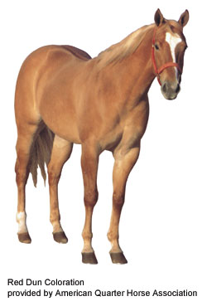
Red Dun
Body color
Form of dun
yellowish or flesh colored
Mane and tail
Red or reddish
Flaxen
Red dorsal stripe
Zebra stripes
Transverse stripe

Slide 14
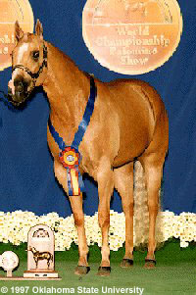
Palomino
Body
Golden yellow, copper
Mane and tail
White or cream

Slide 15
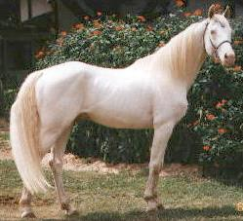
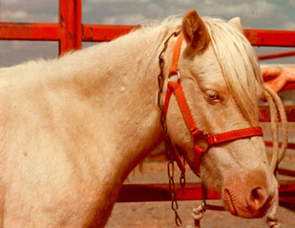
Cremello
Body color
White or light cream
Mane and tail
White
Pink or pinkish skin over entire body
Blue eyes

Slide 16
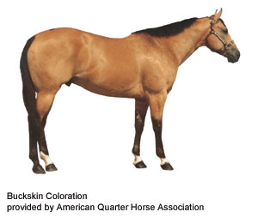
Buckskin
Body Color
Yellowish or gold
Mane and tail
Black
Usually black on lower legs
Typically do not have dorsal stripes

Slide 17
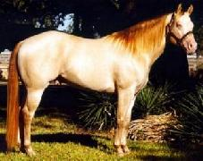
Perlino
Body color
White or light cream
Mane and tail
Usually have a darker tint
Pale copper or orange
Pink or pinkish skin over entire body
Blue eyes

Slide 18
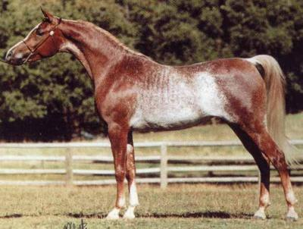
Rabicano
Body
Interspersed white hairs
Most dense from flank to tailhead
Not Roan

Slide 19
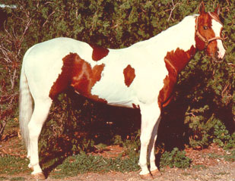
Pinto - Tobiano
Dark color usually covers
One or both flanks
Generally
All four legs are white at least below the hocks and knees
Spots
Regular and distinct appearance of a shield

Slide 20
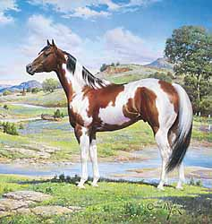
Pinto - Tobiano
Head markings
Like solid-colored horse
May have blaze, strip, star or snip
May be either
Predominantly dark or white
Tail is often two colors

Slide 21
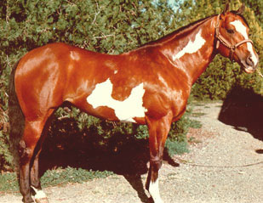
Pinto - Overo
White
usually will not cross back
Between withers and tail
Generally
At least one and often all four legs dark (may have leg markings)
White is irregular
Scattered or splashy

Slide 22
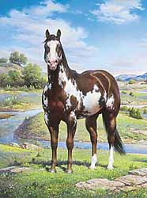
Pinto - Overo
Head markings
Often bald-faced
Body may be either predominantly dark or white
Tail usually one color

Slide 23
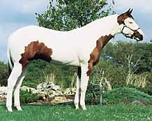
Pinto - Tovero
Dark around ears (medicine hat)
Dark may expand to cover forehead and/or eyes
One or both eyes blue
Dark pigmentation
Around mouth
May extend up sides of face and form spots

Slide 24
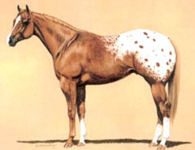
Appaloosa - Blanket
Solid white area normally over hip area that is contrasting to base color

Slide 25
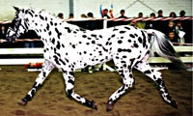
Appaloosa - Leopard
White with spots of color over their body
Sometimes spots are more concentrated on head and leg areas
Spots may also occur in the direction the hair grows and are most evident in the flank area

Slide 26
Facial Markings
Star: white mark on forehead
Strip or Stripe: narrow white mark down the face
Snip: white mark between the nostrils
Blaze: broad white mark down the face, extending over the nose
Bald face: very wide white marking, covering most of the face and extending down over the nostrils. Usually covers one or both eyes

Slide 27
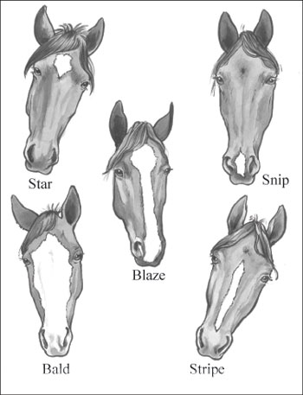
Facial Markings
Star: white mark on forehead
Strip or Stripe: narrow white mark down the face

Slide 28
Facial Markings
Snip: white mark between the nostrils

Slide 29
Facial Markings
Blaze: broad white mark down the face, extending over nose

Slide 30
Facial Markings
Bald: very wide, covering most of the face extending down over the nostrils
Usually crosses the midline of at least one eye

Slide 31
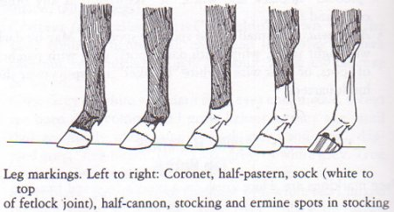

Slide 32
Leg Markings
Coronet: Just over the coronary band
Half-pastern: Half way up the pastern joint
Sock: Covering the fetlock or just over it
Stocking: Half way up the cannon bone and above (but not to cover the knee or hock)

Slide 33
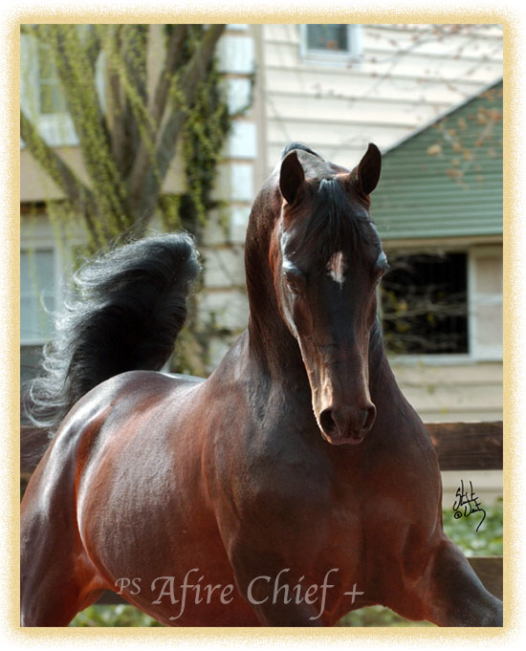
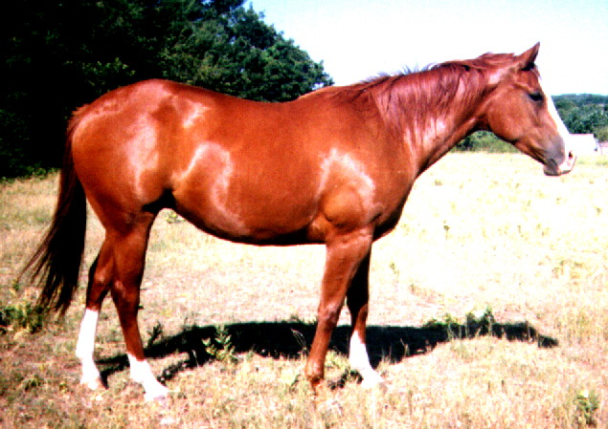
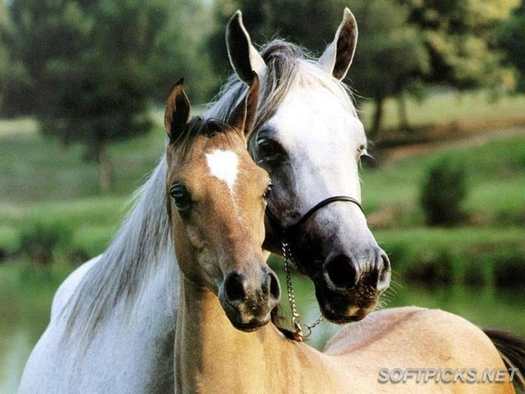
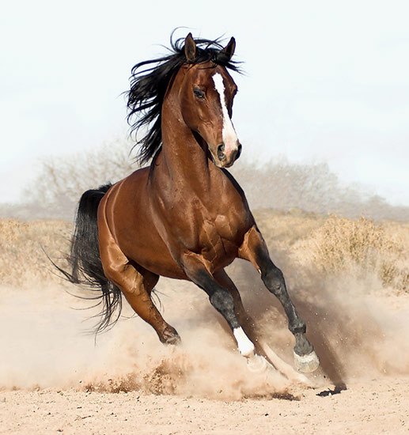
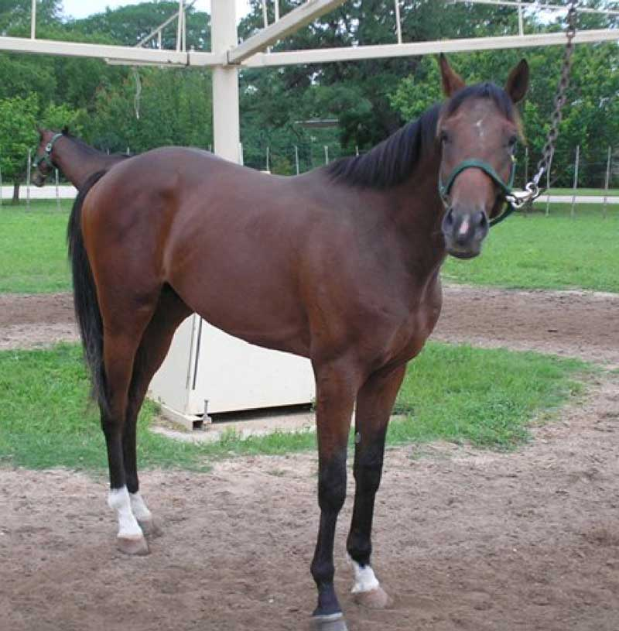
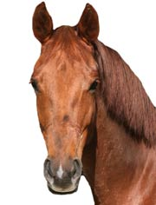
Identify the Markings

