Slide 1
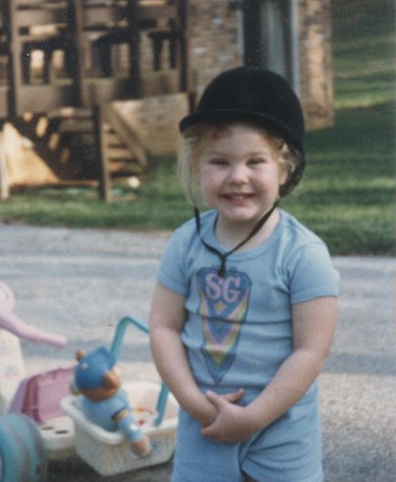
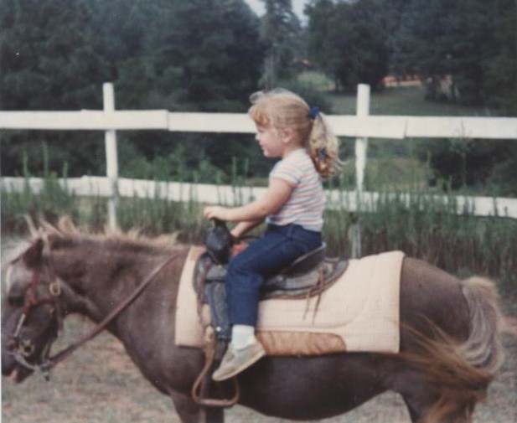
How It All Began
A Glimpse into the Early Years
Laurie Brown
MS Agriculture

Slide 2
Background
- Georgia Equine Industry
- Local Saddle Clubs
- 4-H
- USPC
- Therapeutic Riding
- Summer Camps

Slide 3
Clemson University
- Bachelor’s of Science in Animal Science
- Equine Business
- Intercollegiate Eventing Team, IHSA
- Block and Bridle
- Woodburn Barn
- Sigma Alpha Professional Agricultural Sorority
- Clemson Equine Center

Slide 4
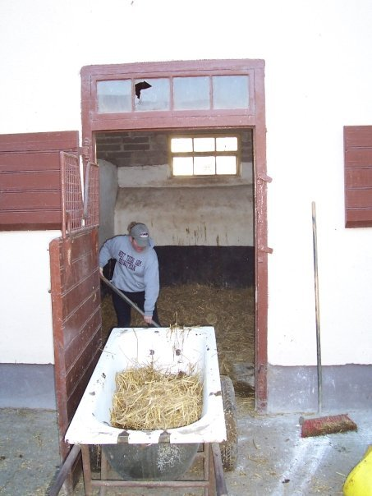
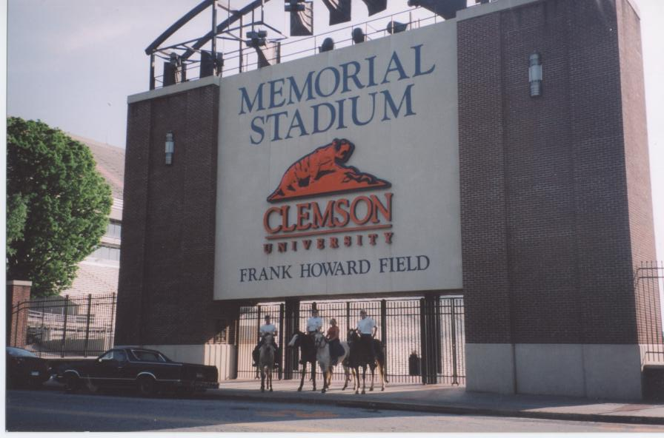
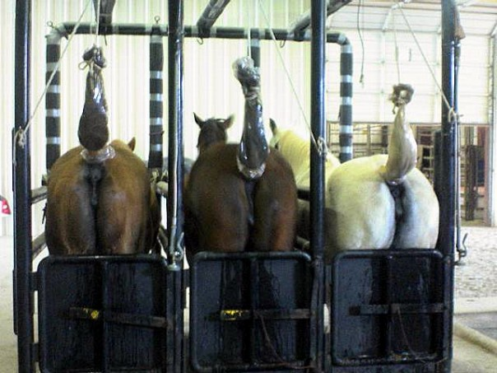
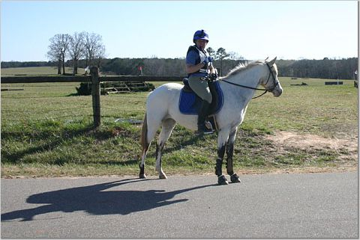

Slide 5
University of Limerick
Ireland
- Equine Studies
- Exercise physiology
- Land management
- Working Student
- Clonshire Equestrian Center, Adare

Slide 6
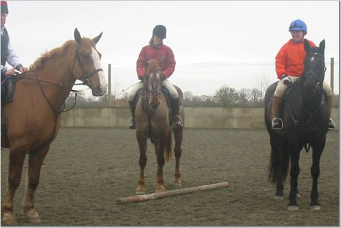
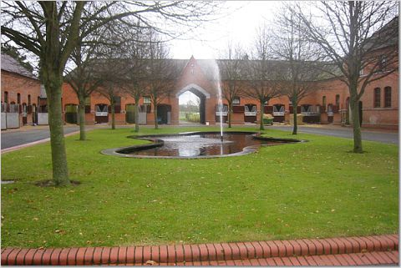
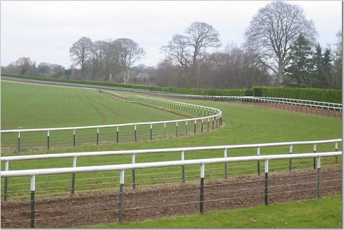
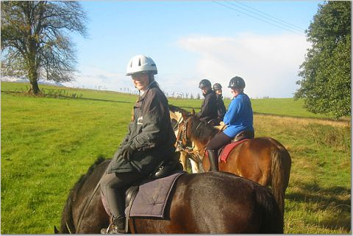

Slide 7
West Texas A&M University
- Master’s of Science in Agriculture
- Equine and Environmental Sciences
- Operations Manager, WTAMU Horse Center
- Organizations
- IHSA, AQHA, 4-H
- Texas Ag Research and Extension Center
- Palo Duro Cowboy Church
- Equine outreach

Slide 8
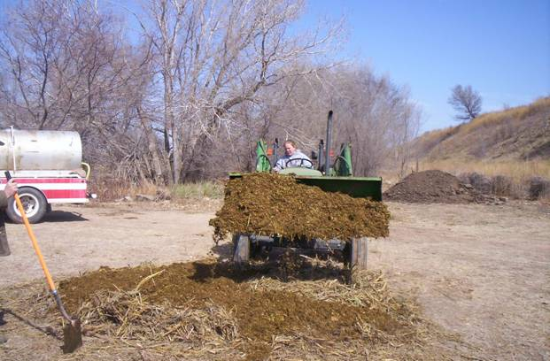
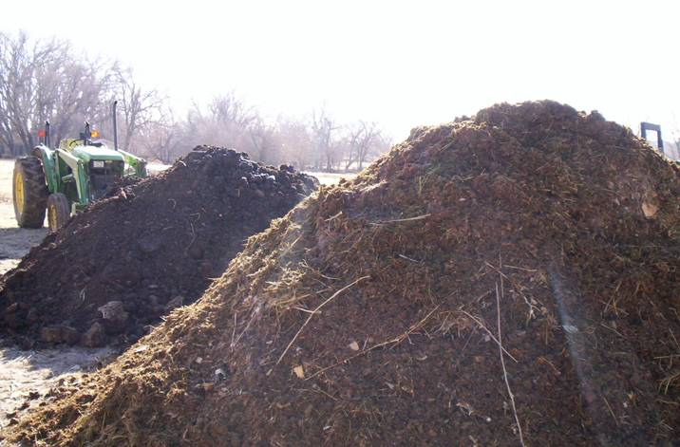
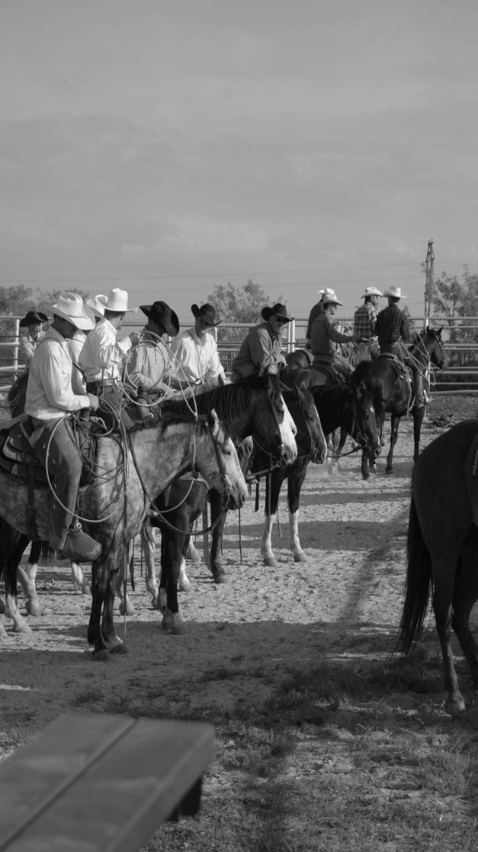
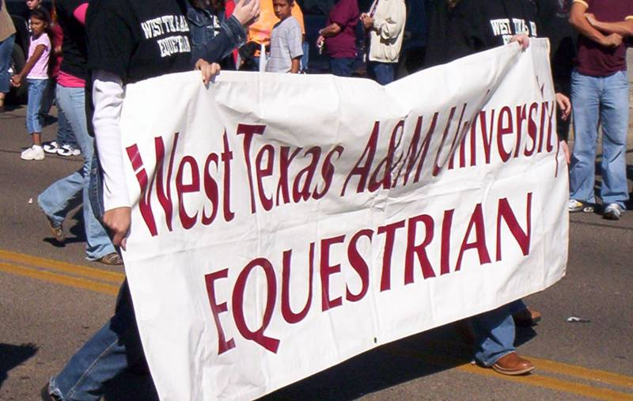
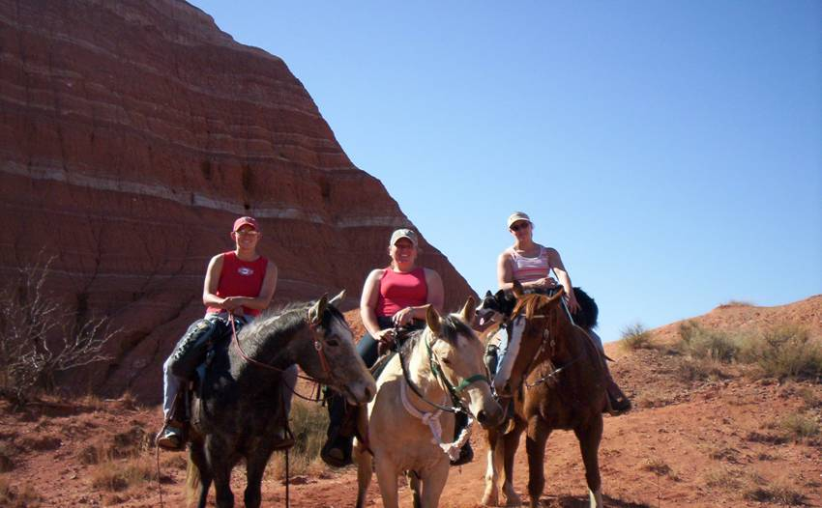

Slide 9
Ireland – Round Two
- Royal Meath Equestrian Centre, Drumree
- Instructor and Manager
- Riding school
- Livery
- Bloodstock yard

Slide 10
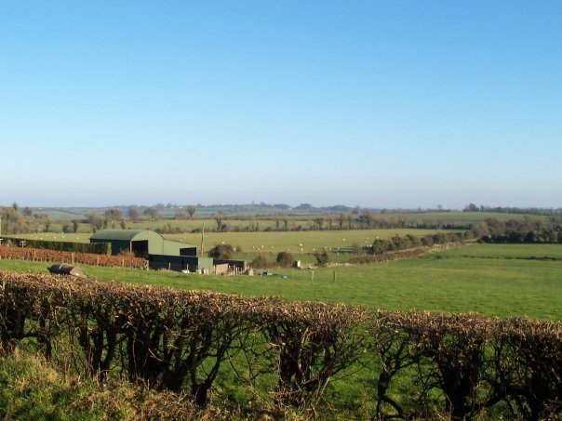
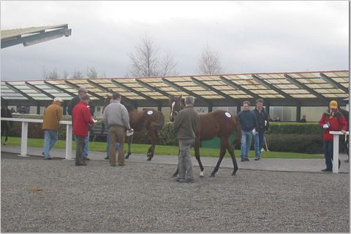
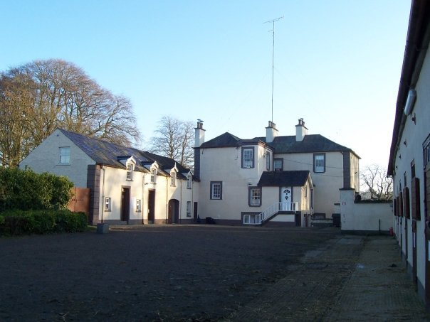
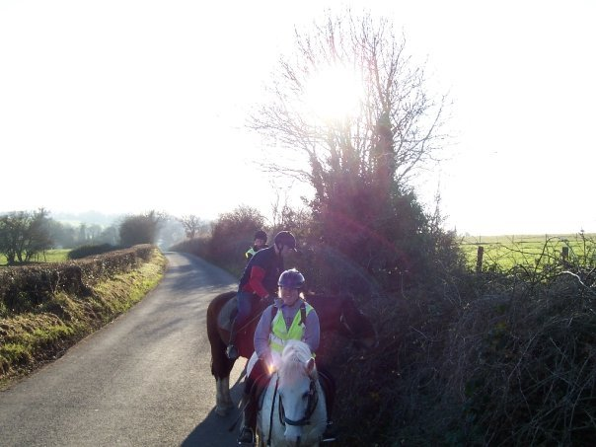

Slide 11
Goals for the Future
- Become an integral part of an international equine facility
- Be involved in agricultural teaching and extension at the university level
- Continuously encourage the connection between university gained knowledge, professional meetings, and practical applications
- Gain administrative positions in equine related youth programs
- Keep up-to-date in an ever changing industry

Slide 12
Brownie Points
- Hands-on, practical approach to teaching
- Enthusiastic recruitment methods aimed at successful involvement and retention of students in agriculture related ventures
- Knowledge to engage students in varying types of university programs
- Involvement in varied levels of national, international, and collegiate equestrian activities

Slide 13
Rig Preparation and Travel Safety
When Hauling Horses
Laurie Brown
MS Agriculture

Slide 14
Overview
- Choosing Your Rig
- Vehicle and Trailer Maintenance
- Safety and Equipment Checklists
- In for the Long Haul
- Trouble on I-40: Tire Blowout
- In Case of Emergency Please Call. . .
- Thoughts for the Road

Slide 15
Choosing Your Vehicle
- SUVs vs Pickups
- Towing capacity
- Braking ability
- All Those Numbers
- Four or six tires
- Two or four wheel drive

Slide 16
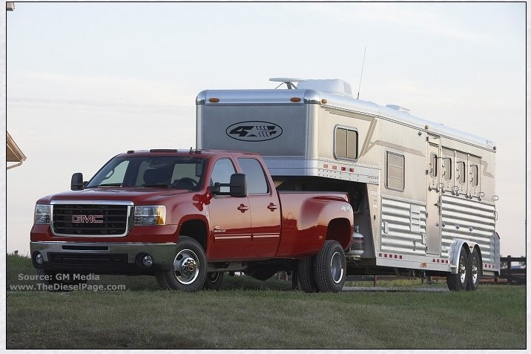
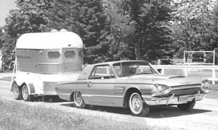
Size
Matters

Slide 17
- Trailer Options
- Tag along vs. gooseneck
- Maneuverability and handling
- Straight or slant, stock, head to head
- How big is your steed?
- Horseboxes

Slide 18
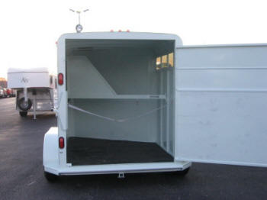
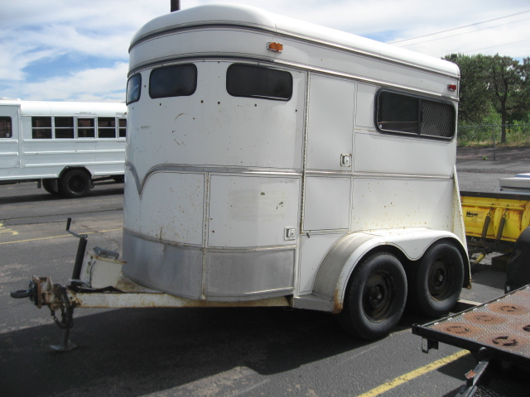
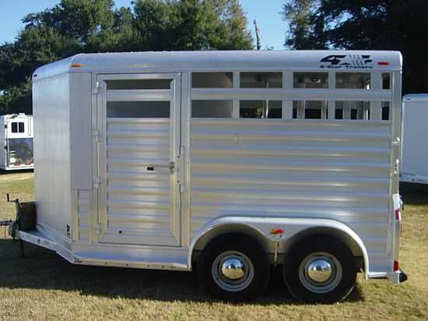

Slide 19
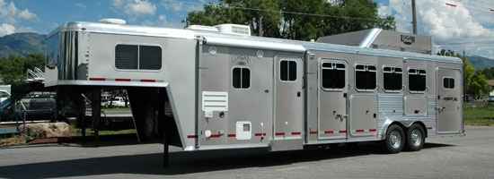
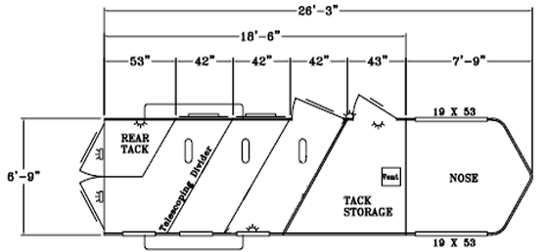

Slide 20
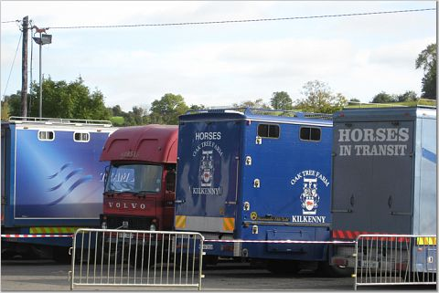
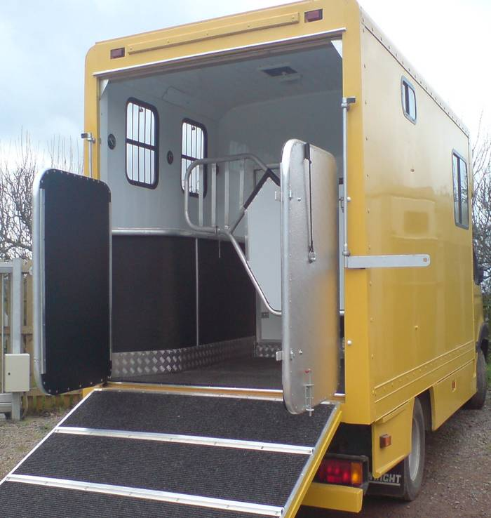
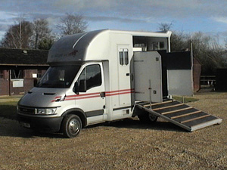
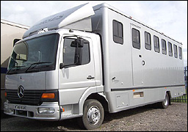

Slide 21
Vehicle Maintenance
- Regular Inspections by Trusted Mechanic
- Engine
- Transmission
- Cooling system
- Brakes
- Lights
- Ball

Slide 22
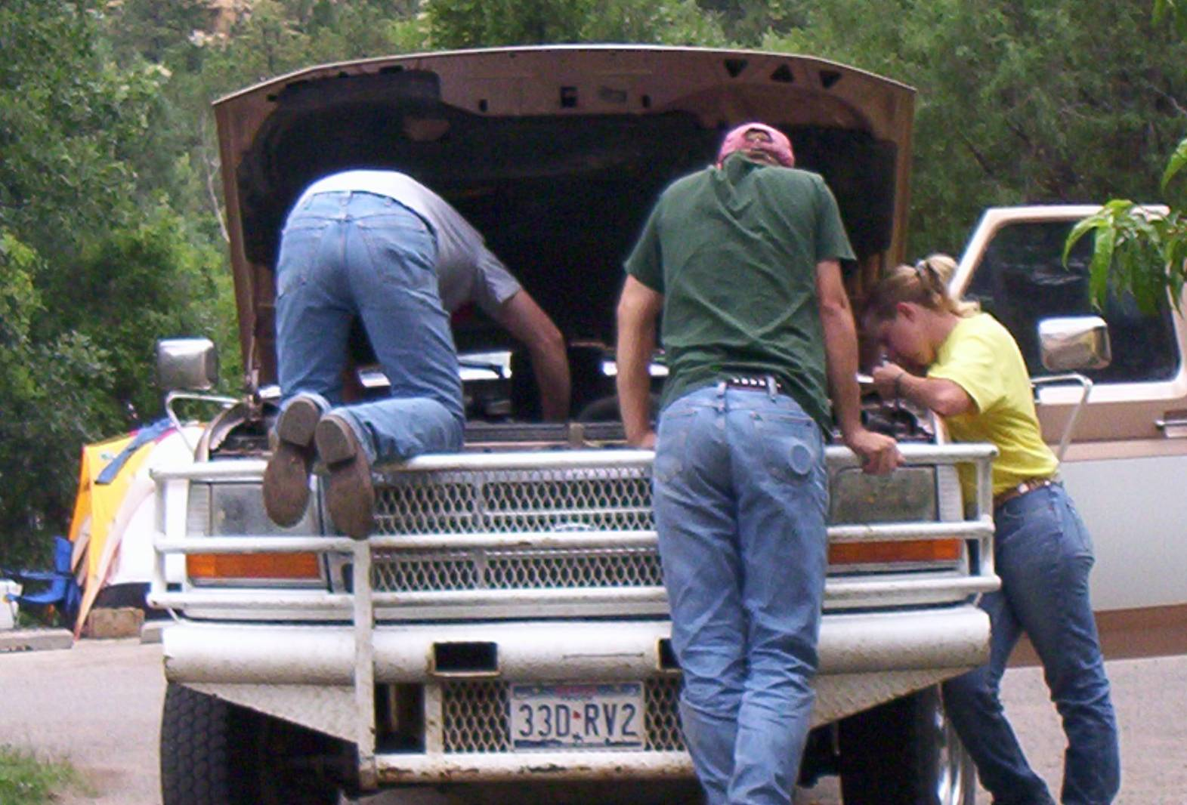
Stranded

Slide 23
Trailer Maintenance
- Check EVERY Time
- Axles, bearings, suspension
- Floor stability
- Partitions, doors, and latches
- Electrical
- Coupler
- Tires

Slide 24
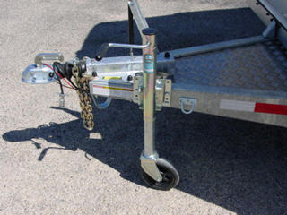
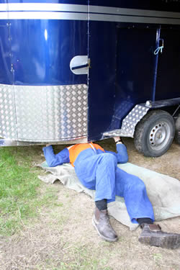
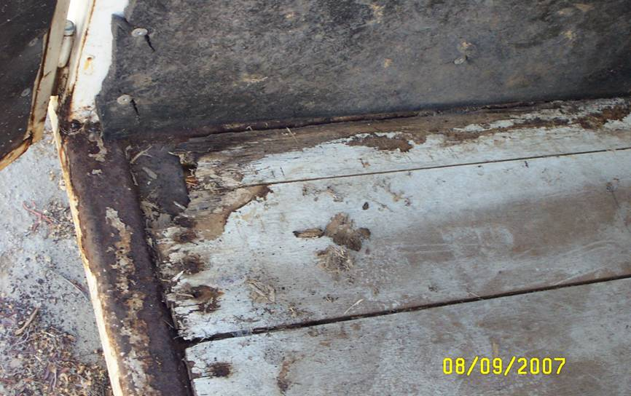
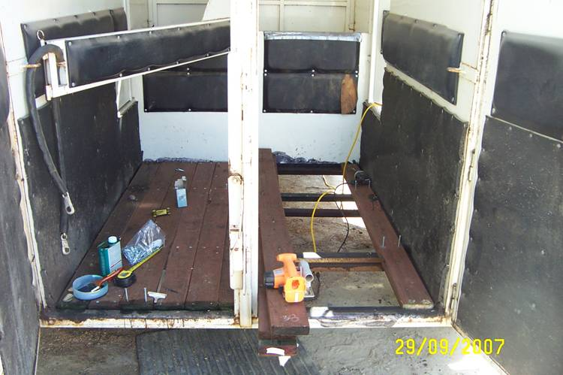

Slide 25
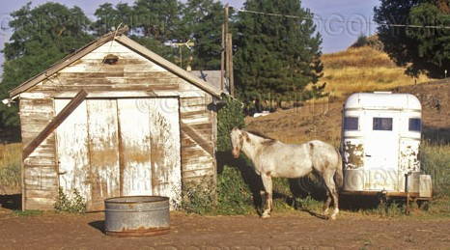
- Weather Precautions
- Winterize properly
- Living quarters
- Keep trailer covered
- Move regularly

Slide 26
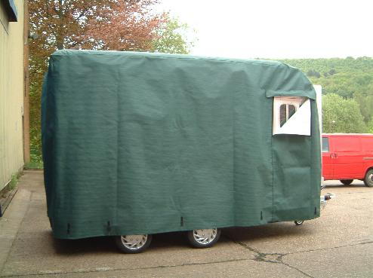
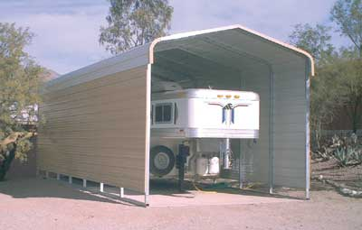

Slide 27
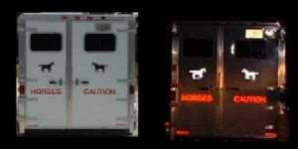
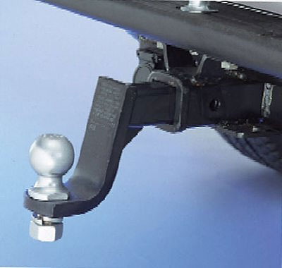
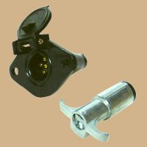
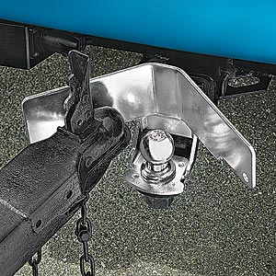
The Rig Itself
- Ball size
- Electrical plugs
- High visibility reflectors

Slide 28
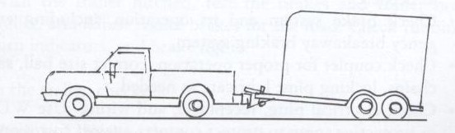
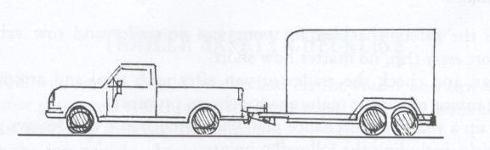
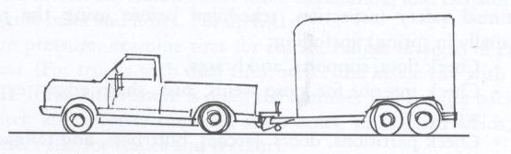
- Loaded Rig Should Sit Level
- Wear on tires
- Instability while driving
- Tiring on horse

Slide 29
Safety Checklist
Before Travel
- Vehicle
- Fluid levels
- Tire pressure
- Ball
- Electrical connections and wiring

Slide 30
- Trailer
- Coupler
- Safety chains
- Lights and wiring
- Floor
- Tire pressure
- Rig
- Hitch and light connections
- Doors and latches once loaded

Slide 31
Equipment Checklist
- Spare tires, jack, lug wrench
- Jumper cables
- Tow chains or straps
- Wooden blocks
- First aid kits
- Road flares or hazard signs
- Tool kit

Slide 32
- Tool Kit
- Flashlight and extra batteries (headlamp)
- Screwdriver, pliers, wrench, hammer
- Extra light bulbs and fuses
- Electrical tape
- Quart of oil
- Knife
- WD40 or lubricant
- Work gloves
- Drinkable water

Slide 33
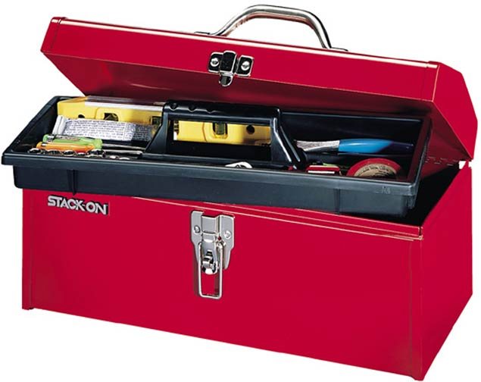
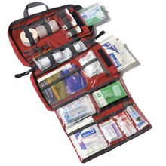

Slide 34
- Additional Gear and Knowledge
- Registration and insurance of vehicles
- Phone numbers of local veterinarians
- Contact information for highway patrol
- Paperwork requirements
- Coggins
- Health papers
- Passports
- Brand inspections

Slide 35
In For the Long Haul
- Plan your route
- Maps
- Travel time
- Phone numbers
- Feed minimal grain
- Wraps or no wraps
- Haul at night

Slide 36
- During The Trip
- Stop every 3-4 hours
- Loosen tie
- Water frequently
- Electrolytes
- Hay nets
- Unloading
- Only when necessary and safe
- Stopping for the night

Slide 37
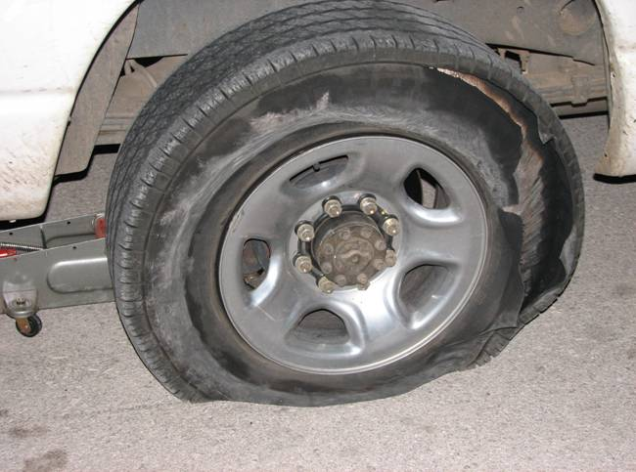
Trouble on I-40: Tire Blowout
- What to do before changing the tire
- Engage flashers
- Decelerate and brake smoothly
- Front blowout
- Pull off in a safe place
- 12 ft from road
- Apply parking brake
- Standard: leave in gear
- Turn off vehicle and put on bright clothing

Slide 38
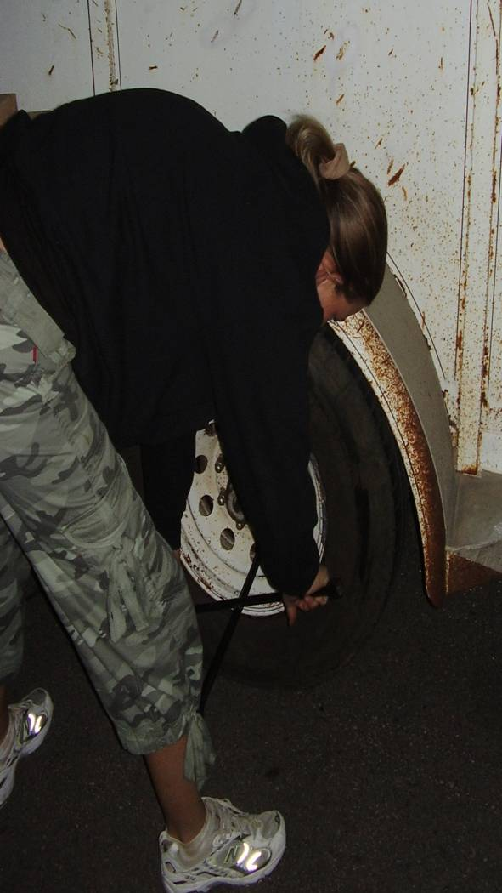
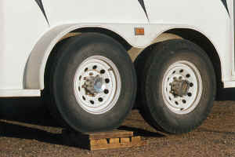
- Chock wheels
- Check horses
- Do NOT open any doors
- Check for damage to trailer
- Do NOT unload horses
- Single axle special case

Slide 39

- Invest in Roadside Assistance for Trailers
- USRider.org

Slide 40

Stranded
. . . Again

Slide 41
In Case of Emergency
Please Call. . .
“Data shows that the main causes of trailer accidents are lack of proper maintenance, operator error, and equipment mismatch”
- Dr. Tomas Gimenez
Leading Expert of Large Animal Rescue

Slide 42
- Write and label an ICE (In Case of Emergency) plan
- Important for first responders
- Have a power of attorney document
- Medical decisions for you and your horses
- Store important documents and information in an obvious place

Slide 43



Slide 44



Slide 45



Slide 46

Thoughts for the Road
- Load single or heavier horses on left
- Lights on at all times
- Drive below speed limit
- Following distance
- Don’t talk on cell phone
- Notify someone at starting and ending points of your travel time and route

Slide 47

Questions?

